Slide 1
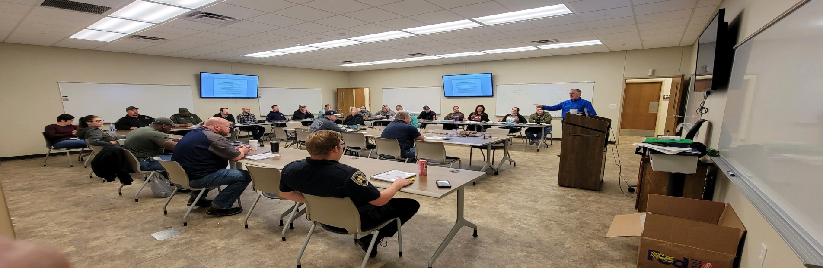


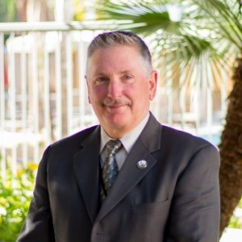


DATES & LOCATION:
August 5th – 9th , 2024
0800 - 1700
Bellingham Police Department
505 Grand Ave
Bellingham, WA 98225
Contact Sgt. Dante Alexander
Bellingham Police Department
(360) 815-1715
Basic FTO (Field Training Officer) Academy
40-Hour Course (5 Days)
San Jose Model (SJM) for Field Training
Designed for Police Officers, Sheriff’s Deputies, State Troopers, and Correction & Detention Personnel.
This class is designed for officers, deputies, troopers, and detention officers who have attended a Basic FTO Academy with a focus on the San Jose Model of FTO. This course will review Adult Learning methodologies as well as review the evaluation rules, the importance of ethical evaluations, issues related to improper documentation, and the importance of like-kind training.
TOPICS REVIEWED:
TO REGISTER, please visit the David J. Harris & Associates website (ftoschool.com), or email ftoschool@gmail.com.
Adult Learning Methodologies
Coach-Pupil Method of Instruction
Evaluation Rules
Formula for Documentation
How to Deal with the Incapable Students
Extensions and Not Responding to Training Issues
The Ethical Considerations of Field Training Programs
Daily Observation Reports (DOR) based on a student’s performance, utilizing the SEGs
Watching videos of a student officer performing various tasks and evaluating performance according to SEGs
Any questions, please contact:
Sgt. David J. Harris (Ret)
(425) 426-6350
ftoschool@gmail.com
Cost: $497.00 per student, which includes training materials. * No refunds if not requested within 30 days of the class.

